Slide 1

Feedback
Competitors:
Please scan this EuroSkills themed AI generated QR code and provide us feedback.
We highly appreciate your input!
Thank you!

Slide 2

Skill 17
Web Development

Slide 3
Module Overview
 | C1 | C2 | C3
Morning | Module A Static Website Design 3h | Module C Backend API 3h | Module E Advanced Web Development 3h
Afternoon | Module B Backend SSR 4h | Module D Frontend 4h | Module F Collaborative Challenge 2h
Notes:
Module A: Implement a static website for a client. Competitors are given structure, breaktpoints. No render frameworks allowed!
Module B: Implement a backend with a database. The backend renders HTML pages.
Module C: Implement a backend which provides a REST API. The solution of module B will be provided (backend & database dump). Competitors have to extend the provided database.
Module D: Implement a frontend which consumes the REST API from Module C. The solution of module C will be provided.
Module E: Competitors will receive 3 separate tasks which all involve using native and advanced Web features that the browser provides. Frameworks will not be used.
Module F: Competitors form groups and collaboratively work on a creative idea and then present it to the other groups.

Slide 4
Module F

Slide 5
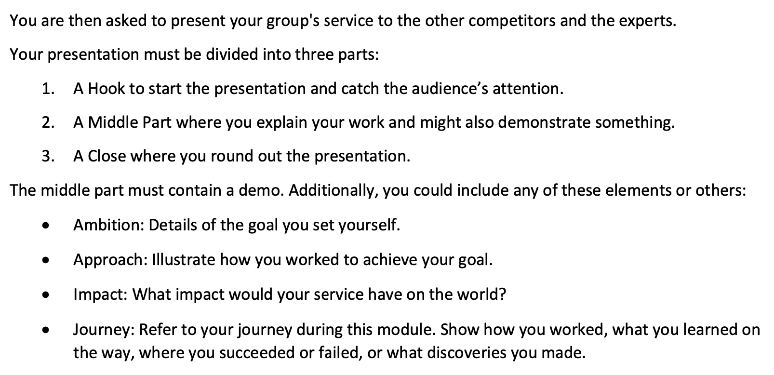
Module F

Slide 6
Module F - Assessment
Split work among group members.
Build a prototype (even if it's just a Slide Prototype).
Include in your presentation:
Hook
Middle Part (incl. Demo)
Close

Slide 7
Module F - Organisational
You have access to the Internet. 🐌
Your presentation should last 4-6 minutes.
To share something on the screen, you can provide us a link that we will open in the browser. E.g.:
Google Slides
Reveal.js
A deployed website using our Gitlab.

Slide 9
Module F - Group Formation
Instructions:
Think of a word or short phrase (<25 characters)
Adhere to EuroSkills code of conduct.
We enter your word or phrase.
No prompt injection allowed!

